Slide 1
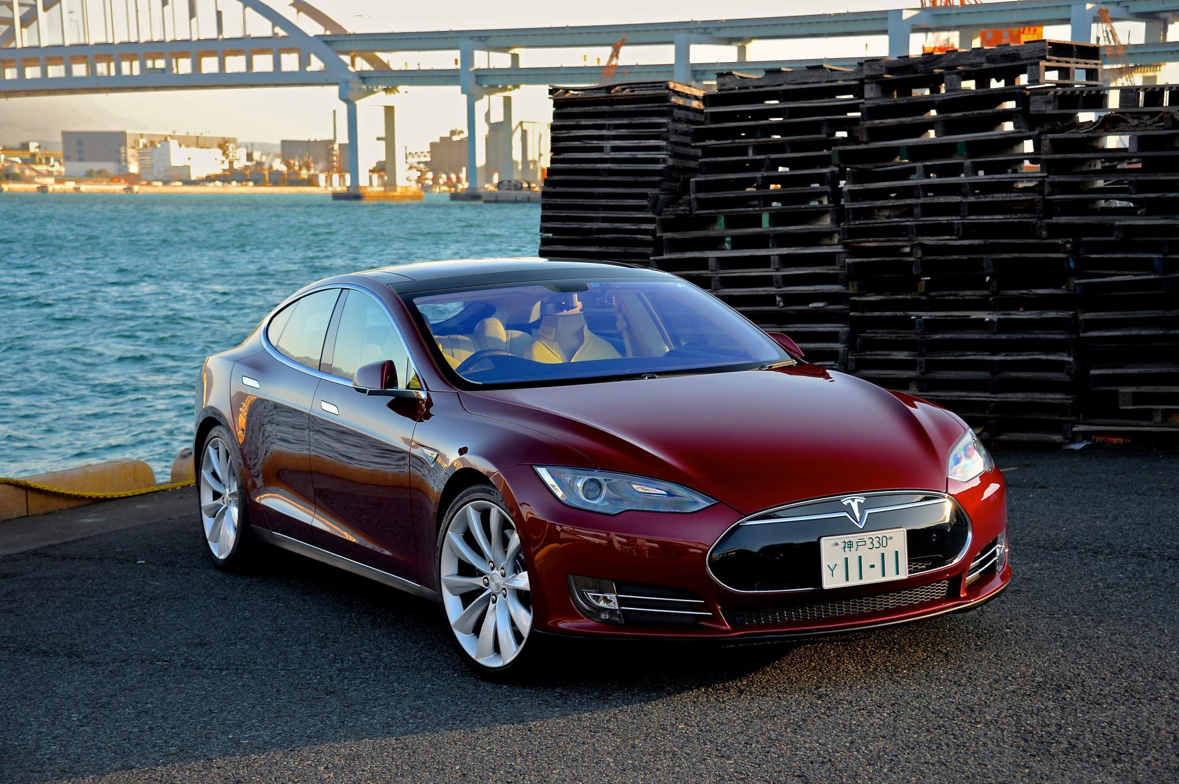
AI4ALL Final Project
Self Driving Cars
Notes:
BOTH?: Howdy everyone.
Welcome to our AI4ALL Final Project Presentation and we are focusing of the specific AI application of Self Driving Cars

Slide 2


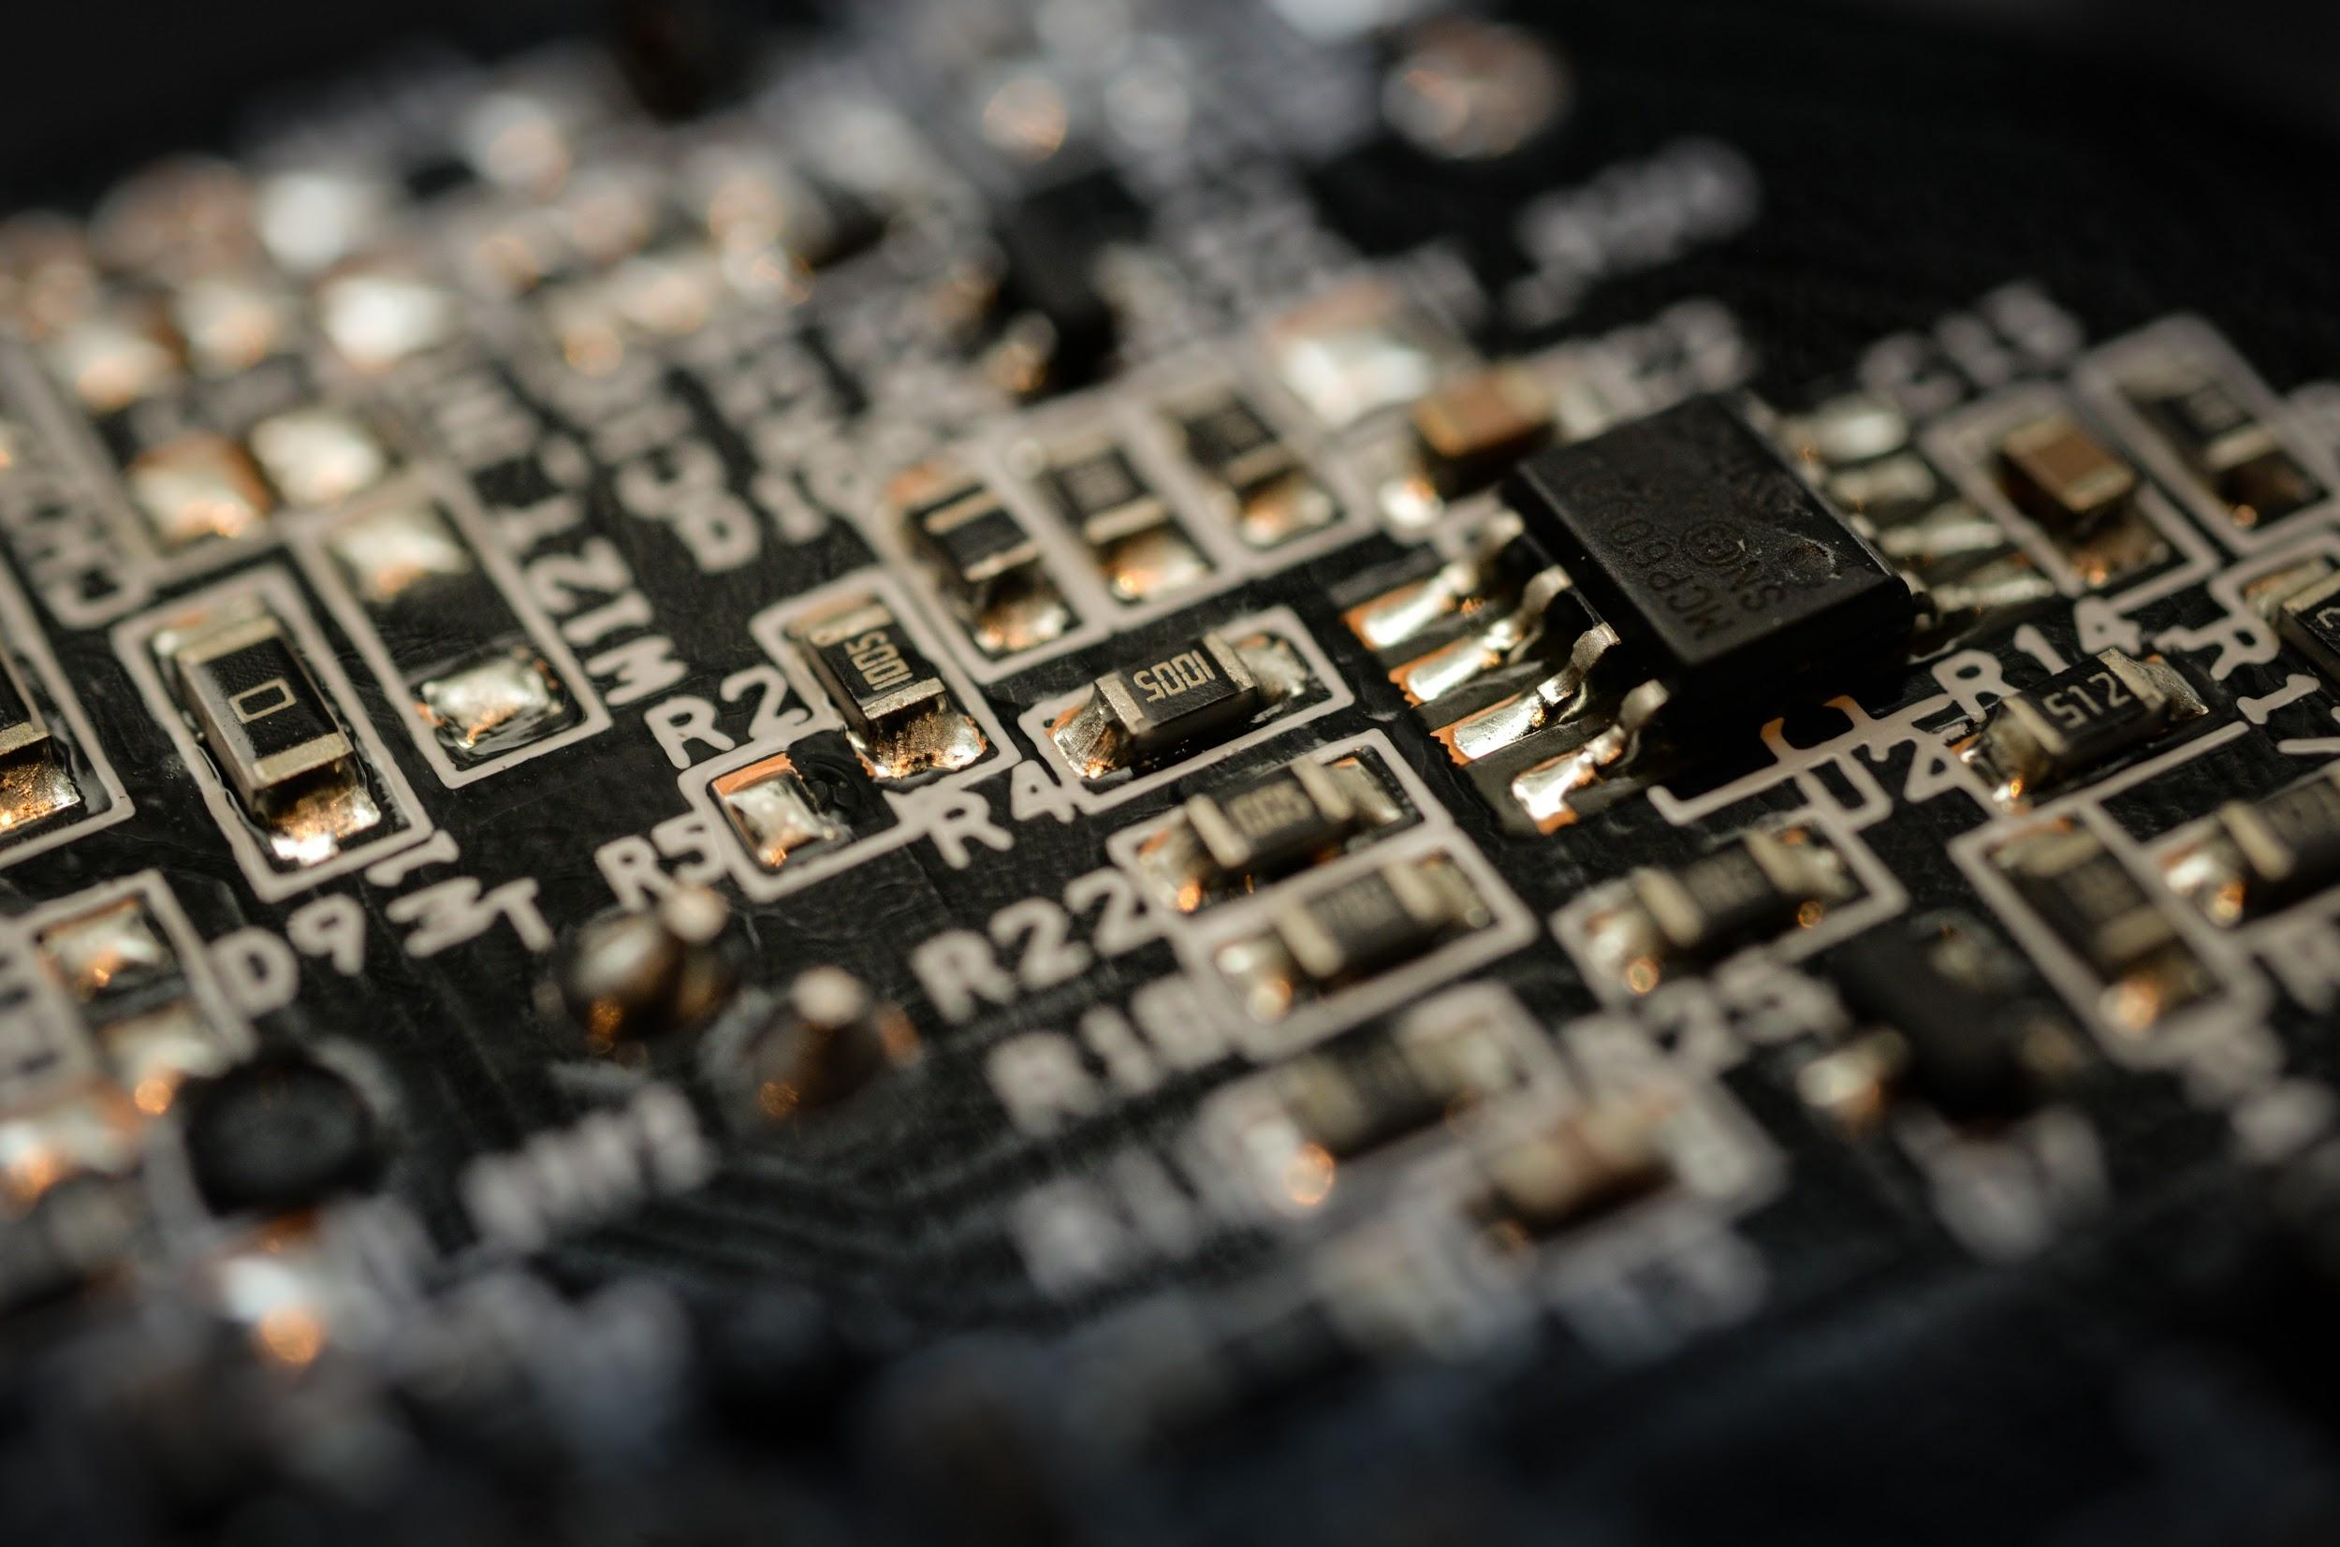


Who are we?
Ian Wang
Working towards a bachelor’s degree in Electrical Engineering with double minor in Computer Science and Business.
Graduating 2023 and future plans are so far graduate school and hopefully working for Tesla.
David Cornejo
Working towards a Bachelor’s degree in Electrical Systems and minoring in Computer Science
Graduating 2023 and future plans is to work for a Large Tech company
Notes:
DAVID: Hello, my name is David. I am a third year student at Texas A&M University, studying Electrical Systems and as well as a minor in Computer Science. I graduate in the year 2023 along with my career goals in working for a Large Tech company like Apple or Google.
IAN: Howdy everyone, my name is Ian. I am also a third year at A&M, and looking to major in electrical engineering with a double minor in computer science and business. In the future, I would like to study for a master of science in a related discipline, and hopefully one day work with self-driving cars for Tesla.

Slide 3





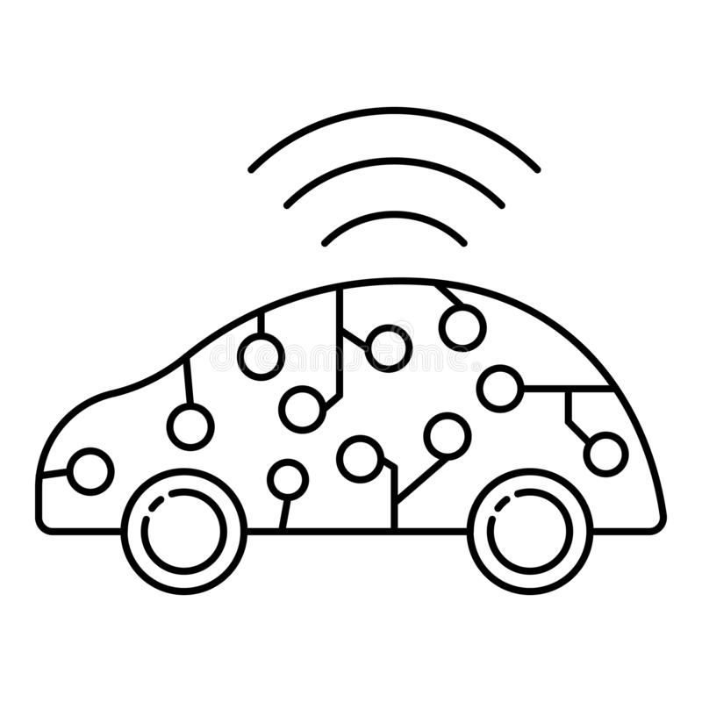
How can Artificial Intelligence impact our World?
Customer Service
Manufacturing
Healthcare
Education
Media
Transportation
Notes:
DAVID: Artificial intelligence, or AI, can impact our world on so many levels.
-Starting with Customer Service, a short example is that companies can quickly and more efficiently help customers through computerized answering machines.
-Next is Manufacturing, such as how Henry Ford invented the the assembly line, with the help of AI and Robotics, assembly lines can make products with near-perfect accuracy.
-Healthcare is a growing industry, as an example people wear AI on their smart watches that keeps a close eye on a person’s vitals as well as people wanting to use Smart Contactless Thermometers.
-Next for Education- I am sure we are all well aware of the technological advancements in online learning. We can join a class through video call, but now a sophisticated grading-site can learn from a students grades on which student needs to most help in that class.
-Media has also been a growing industry during the last 10 years, as media services such as TikTok or Instagram- The AIs job is to keep the user hooked on their app as long as possible. Which is good for business- and well, not good for late night study sessions.
-And Finally, Transportation. This is the application we are focusing on for you all today. I am going to pass it on to Ian for a more in depth explanation.

Slide 4
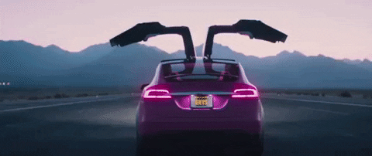
AI in Vehicles
ML and AI in cars has rapidly grown over time
Never have to be behind the wheel again.
Notes:
IAN: Machine Learning and Artificial Intelligence has been improving rapidly year-over-year and slowly becoming more reliable. But where did the idea of self driving cars come from? It was an idea in movies for many years such as Transformers, with the first self-sufficient and truly autonomous cars appearing in the 1980s, with Navlab. Since then, many major companies and research organizations have developed working autonomous vehicles with the biggest name being Tesla. Tesla as we know it is the leader of this industry and will continue that way for the foreseeable future. Not only are their cars reliable and widely accepted, they are also affordable with their Model 3 starting at $33,690. The leader in this industry would be Elon Musk’s Tesla whose cars are currently partially able to drive on its own. If self-driving cars become perfected, one would never have to worry about accidents again, nor worry about having google maps open while driving to prevent getting lost. Research has shown that accidents happen due to human error and thus a reliable algorithm can prevent any and all errors from taking place in the near future. In the gif shown to the right, the audience can observe that one can safely ride in the back seat of a self driving car with no worries whatsoever. An example of a case where machine learning wouldn’t be able to weather the situation, would be weather itself (no pun intended).
More advanced study would need to take place for cars and AI to safely drive on icy roads, severe thunderstorms, and other weather conditions that can hinder the performance of a self driving car, which we have trouble getting a hold of already without the aid of artificial intelligence.
How exactly is Machine Learning and Artificial Intelligence placed into vehicles? Well it is now possible that voice assistants be included within a car which can aid drivers whilst in route to their destination. Additionally, machine learning algorithms can recognize and determine best course of action whether that be to steer a certain direction, take a detour, or make a stop.

Slide 5
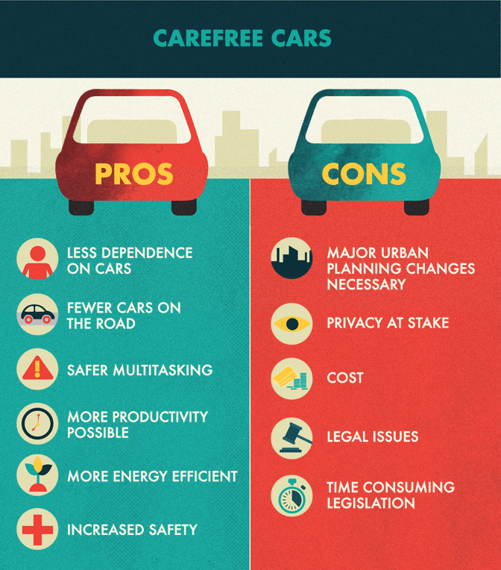
The Possible Repercussions
Perfecting self driving cars can be costly and carry many uncertainties.
Notes:
IAN: Creating the picture perfect self-driving car is extremely costly as it takes up a mountain of resources and manpower. It takes a lot of technical knowledge to develop and perfect these cars, and most importantly, to maintain the algorithms and machine learning that constitutes self driving cars. Malfunctions, glitches, and adaptation to surroundings are all areas of concern, and so far is not anywhere near perfection. Other drawbacks would be licensing as well as potential loss of privacy. With self-navigation comes the possibility that a third party tracking your whereabouts as your car would be sending and receiving data to and from data centers as you move about. There is a lot of trust that comes to play for one to let their lives be in the hands of artificial intelligence, but in the end, it will be well worth it. Not only does it bring safety and minimal error to our roads, but also creates new jobs and demand for technical and creative minds all over the world. That’s what I have to share on this topic and I will now pass it on to David.

Slide 6
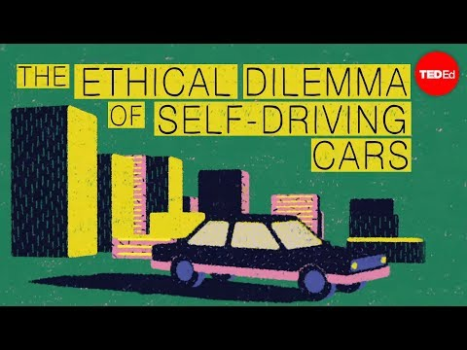
The Ethics of Self Driving Cars
Notes:
DAVID: Just as what Ian said; Self Driving cars can prevent any future car accidents and no more traffic as all cars can avoid each other on the road, but the issue is that we must hand our lives in the safety of the AI. This situation is popular within Computer Scientists and Engineers, which is this video perfectly introduces the ethical issues of self driving cars. *video*
I will quickly play for you a short video.
This problem is only introducing the ethics of self driving cars, as the goal is to put top priority on safety and efficiency into the passengers.
So to solve the problem, would we program the car to swerve to hit the motorcycle, as it is statistically proven that motorcycle drivers are at the most risk of severe injuries in an road accident?
Or should we program the car to always hit other safer options, as hitting against a heavier vehicle such as a SUV, which is proven to be the safest during car accidents?
Or should we program the car to make the decision to crash forward, into the truck which puts the passengers at the most risk of injury?
As you can realize, we still have a long way to go until we have the perfect self driving car. But until then, engineers have plenty of work to bring back to the drawing board.

Slide 7
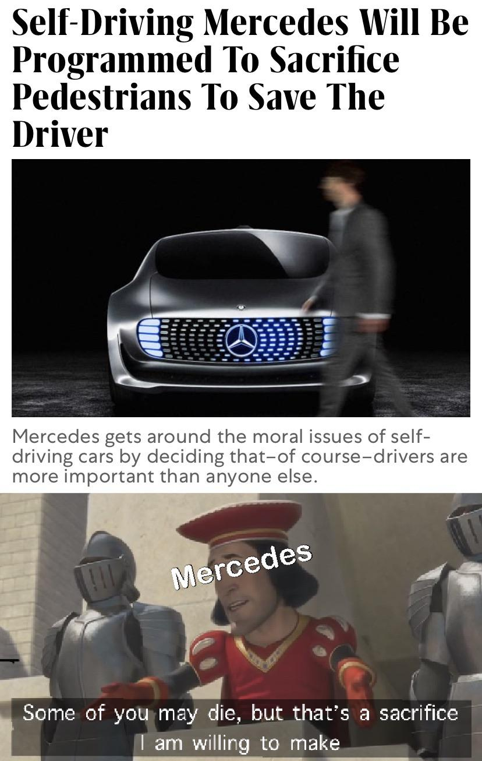
Bonus Videos
AI Designed this Car - Donut Media
AI and Ethics - TED Talk
Hewlett Packard - Moral Code: The Ethics of AI
Notes:
DAVID: Now, while Ian and I have been researching for the presentation, there are plenty of more videos to watch on the topics of AI within the transportation market. I will leave this screen here for a few more seconds so that you may take a quick picture or write down the titles for a quick watch after this presentation.
Furthermore, there is a self-driving meme on the right while we wait for those taking notes. *3 seconds*

Slide 8
Sources
https://builtin.com/artificial-intelligence/artificial-intelligence-future
https://www.mckinsey.com/industries/automotive-and-assembly/our-insights/self-driving-car-technology-when-will-the-robots-hit-the-road/de-de
https://www.pinterest.com/pin/266275396697253426/
https://www.youtube.com/watch?v=ixIoDYVfKA0&ab_channel=TED-Ed
https://i.kym-cdn.com/photos/images/original/001/674/673/544.jpg
https://en.wikipedia.org/wiki/History_of_self-driving_cars
Notes:
DAVID: Now here is a quick look of the sources we used for our presentation.
IAN: These sources would be great to take a look, if you so wish, as they were all very helpful in aiding the completion of our presentation today.
*3 seconds*

Slide 9
Questions?
https://tinyurl.com/CarQuestions
Notes:
DAVID: And here is the end to our presentation, and as Ian and I would like to have been presenting this live, we would like to still give everyone a chance to message us any questions or concerns you may have, with this quick link we have created for you.
It is only a short Google Forms link that asks for your question, and you can optionally add your name and contact info so we can get back to you.
And before we end our presentation on such a low note, about ethical dilemmas.

Slide 10
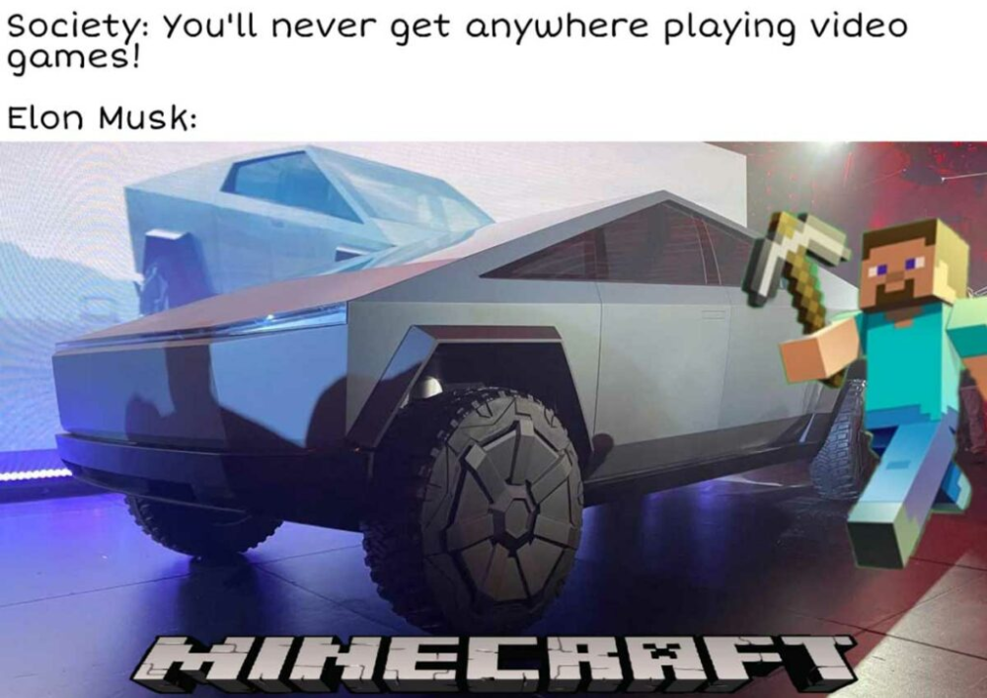
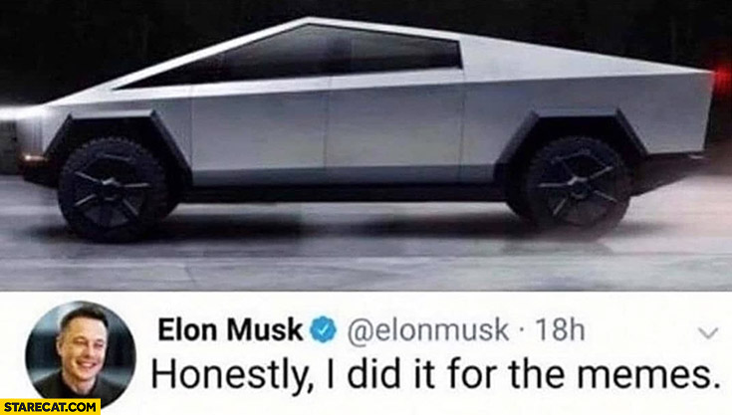
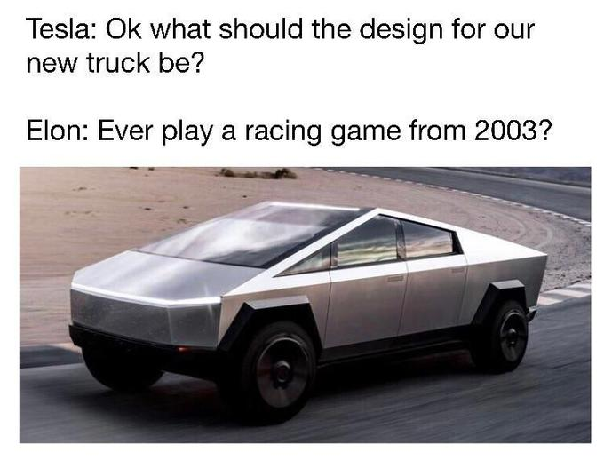
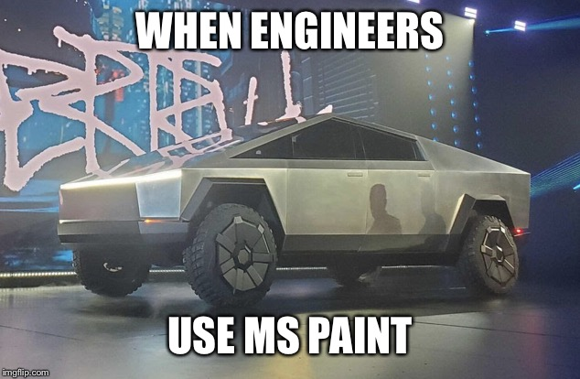
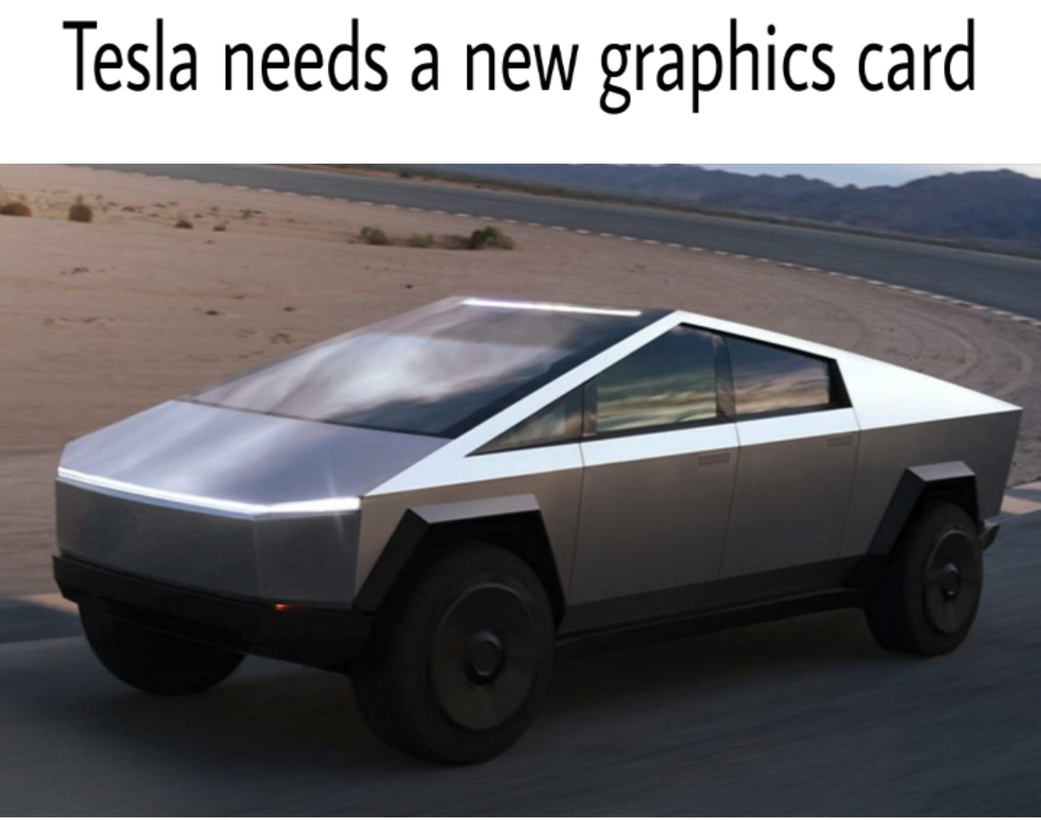
Bonus Meme Time!
Notes:
DAVID: Here is a quick slide everyone can cheer up, with some Tesla memes.
Ian: Thank you for your attention. We hope you enjoyed our tour of self-driving cars, and stay safe.

